Slide 1


Locator Strategies
January 2019
1
Notes:
‹#›

Slide 2
Locator
Required parameter for webdriver commands
findElement()
findElements()
and other selenium objects / methods
Identifies an element in the content of the web application
Consists of the location strategy followed by the location
By.locatorType(location)
Notes:
‹#›
Slide Number

Slide 3
Locator Categories
Selenium WebDriver supports two main locator categories
cssSelector
xPath
For convenience a number of subcategories are also available
id
class
name
linkText
partialLinkText
Notes:
‹#›
Slide Number

Slide 4
Choosing Locator Strategy
If an element contains an id attribute – locating the element by id is preferred
Faster execution
Less susceptible to breakage due to changes within UI
If an element contain a unique class attribute or a combination of unique attributes - locating the element by CSS is preferred
Faster execution than XPath
If an element must be located by its TEXT_NODE or its relationship to other elements – XPath must be utilized
higher versatility
Notes:
‹#›
Slide Number

Slide 5
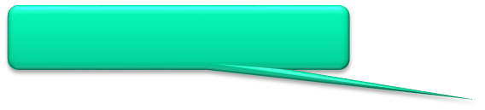
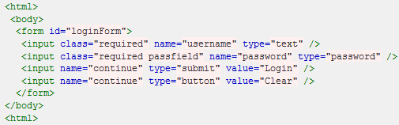
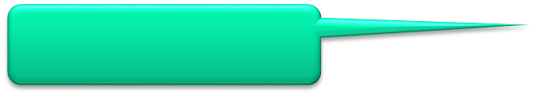

Locating by CSS
CSS selectors can be used by Selenium WebDriver to locate web elements
To locate by css class attribute append the class name to the parent tag name using a period (.)
To locate by css id attribute append the id name to the parent tag name using a pound character (#)
To locate by any other attribute, include the attribute name and value in square brackets next to the parent tag name.
css=form#loginForm
css=input
[name="username"]
css=input.required.passfield
[type=“password"]
Notes:
‹#›
Slide Number

Slide 6
Locating by CSS
To explicitly document a parent – child relationship between two html tags use the more-then (>) character
form>input[value="Login"]
To document relative ancestral relationship between two tags use a single space
body input[value="Clear"]
CSS locator strategy cannot be used to locate tags that are before or above the current tag
Including tag names is optional
#loginForm .passfield
Notes:
‹#›
Slide Number

Slide 7
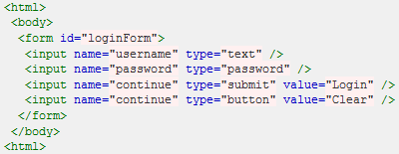
Locating by XPath
XPath locator which begin with “//” are relative
//input[@name='continue'][@type='button']
//body/form/input[4]
XPath locator which begin with “.//” are relative to the current WebElement
It is possible to locate parent WebElements with XPath using "/.."
//input[@name='password']/..
Notes:
‹#›
Slide Number

Slide 8
Locating by Text with XPath
< id="btnTable">
<tr class="row">
<td><label>Apples</label></td>
<td><input/></tdtable>
<tr class="row">
<td><label>Oranges</label></td>
<td><input/></td>
</table>
Web elements can be located by exact text using the text( ) command
//label[text()="Oranges"]
It is also possible to locate web elements by partial text using the contains( ) command
//label[contains(text(),"ange"]
Additionally contains( ) command can also be used to locate web elements by partial value of any attribute
//tr[contains(@class, "ow")]
Notes:
‹#›
Slide Number

Slide 9
Locators Cheat Sheet
Goal | CSS | XPath
All Elements | * | //*
All P Elements | p | //p
All Child Elements | p > * | //p/*
Element By ID | #foo | //*[@id=’foo’]
Element By Class | .foo | //*[contains(@class,’foo’)]
Element With Attribute | *[title] | //*[@title]
First Child of All P | p > *:first-child | //p/*[0]
Next Element | p + * | //p/following-sibling::*[0]
Parent of Element E | Not possible | //E/..
Notes:
‹#›
Slide Number

